Slide 1
Impacts of Oil Spills
CGPRT(W) : Ensuring Clean Seas and Coasts in Western Region ……

Slide 2
Objective
To be aware of and recognize the impacts of oil spills
CGPRT(W) : Ensuring Clean Seas and Coasts in Western Region ……

Slide 3
Impacts of Oil Spills of oil spills
Oil spills can adversely impact:
  health and safety due to oil toxicity
  social and economic activities (e.g. fisheries)
  marine and coastal environment
Impacts can be from:
  interference with activities
  smothering
CGPRT(W) : Ensuring Clean Seas and Coasts in Western Region ……

Slide 4
Oil Toxicity
Will depend on:
  oil type and the amount
  the exposure duration
  sensitivity of organisms
Toxic components:
  Polycyclic Aromatic Hydrocarbons (PAHs)
  light fractions
    BETX (Benzene, Ethylene, Toluene, Xylene)
  heavy metals
CGPRT(W) : Ensuring Clean Seas and Coasts in Western Region ……

Slide 5
Oil Toxicity
Generally:
  Light oil: effects are from oil toxicity
  Heavy oil: effects are from smothering of organisms
CGPRT(W) : Ensuring Clean Seas and Coasts in Western Region ……

Slide 6
Impacts of Oil
Important to differentiate between impacts to individuals and those to population.
  A few individuals may suffer severe adverse effects with no impacts to overall population.
Impacts from oil have been studied since the first major shipping incidents.
Generally, short term impacts with moderate to low long term impacts.
CGPRT(W) : Ensuring Clean Seas and Coasts in Western Region ……

Slide 7
Factors Affecting the Impact of Oil
Type of oil and degree of weathering
Biological characteristics of the area
Geographic location
Degree of oiling
Oceanographic conditions
Season
Choice of response strategy and effectiveness of response
CGPRT(W) : Ensuring Clean Seas and Coasts in Western Region ……

Slide 8
Impacts on Social and
Economic Activities
CGPRT(W) : Ensuring Clean Seas and Coasts in Western Region ……

Slide 9
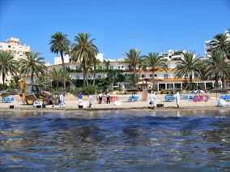
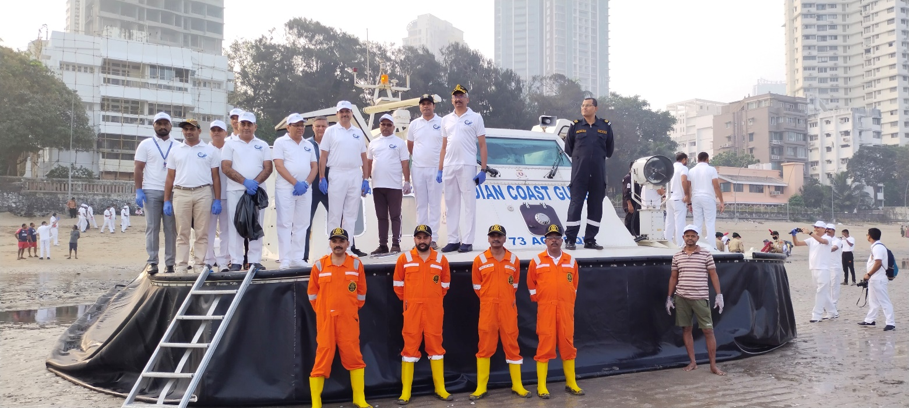
Social and Economic Activities
Presence of oil will interfere with normal activities.
Can cause financial losses and loss of enjoyment.
All coastal activities can be impacted.
Source: ITOPF
CGPRT(W) : Ensuring Clean Seas and Coasts in Western Region ……

Slide 10
Social and Economic Activities
Impacts on tourism:
  Important for many coastal communities
  Direct oil impacts on beaches and coastal structures can lead to closures
  Potentially fewer clients for restaurants, hotels, water parks, etc.
  Positive financial impacts from oil spill workers
  Impacts are generally short lived and activities resume following clean-up, however there can be significant image damage that may persist
CGPRT(W) : Ensuring Clean Seas and Coasts in Western Region ……

Slide 11
Social and Economic Activities
Impacts on water intakes:
  Many industries need water to function properly:
    Power and desalination plants
    Fish plant
    Aquarium, pools, etc.
  Oil in a water intake can lead to contamination of water supply, malfunctions, etc.
  Can have serious implications for power plants and desalination activities.
  Important to protect these areas to avoid contamination.
CGPRT(W) : Ensuring Clean Seas and Coasts in Western Region ……

Slide 12
Social and Economic Activities
  Impacts on ports and marinas:
    Ports are the entrance or exit for many essential goods and trade.
    Ports and marinas can be affected by:
      Navigation channels closed or restricted
      Contamination of structures such as wharves, jetties, etc.
      Contamination of vessels
      Closure or limited access due to response operations (booms)
    Cleaning of vessels is often required.
    Contaminated structures can be difficult to clean
CGPRT(W) : Ensuring Clean Seas and Coasts in Western Region ……

Slide 13
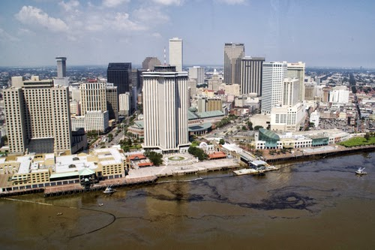
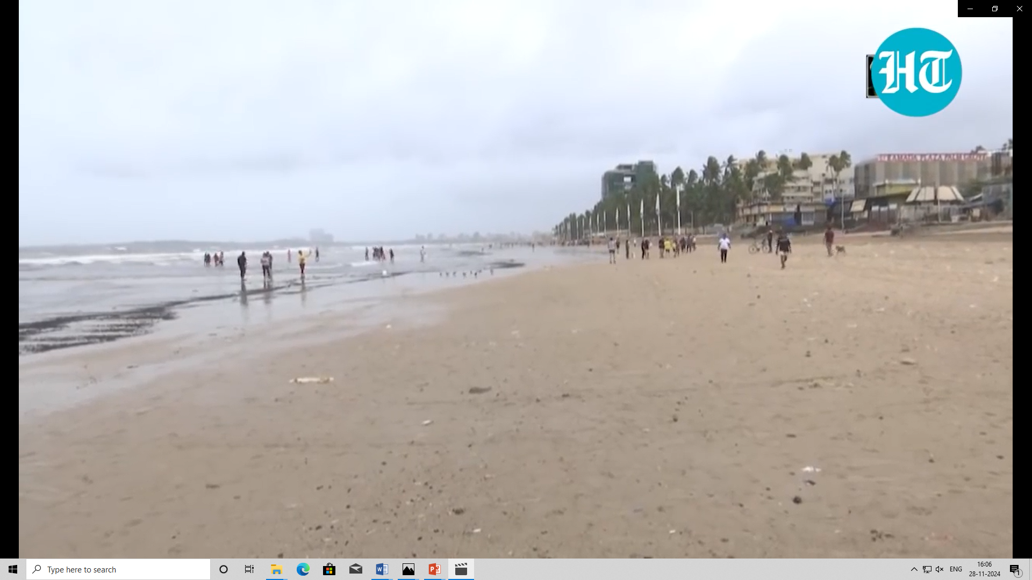
Social and Economic Activities
Examples of impacts
CGPRT(W) : Ensuring Clean Seas and Coasts in Western Region ……

Slide 14
Social and Economic Activities
Impacts on coastal communities:
  In many parts of the world, populations live near or on the coast.
  Exposure to oil vapours can cause breathing difficulties, headaches and nausea.
  Usually, vapours are present at the beginning of a spill and the impact is likely to be short-lived.
  Daily activities can be impacted by the presence of oil and by response operations.
CGPRT(W) : Ensuring Clean Seas and Coasts in Western Region ……

Slide 15
Social and Economic Activities
Impacts on archaeological sites and coastal artefacts:
  Many archaeological sites and associated artefacts are found in coastal areas.
  These areas can be contaminated by direct contact with oil.
  These areas are very sensitive and clean-up methods must be adapted to preserve these sites.
  Archaeologists are required to identify these areas and to provide recommendations for clean-up.
CGPRT(W) : Ensuring Clean Seas and Coasts in Western Region ……

Slide 16
Impacts on Marine Environment
CGPRT(W) : Ensuring Clean Seas and Coasts in Western Region ……

Slide 17
Impacts on Marine Environment
Plankton
  Very sensitive to oil
  Affected by dispersed oil (naturally or chemically)
  Mortality is compensated by over production of young life stage and recruitment from non- affected area
  Significant decline has not been observed following an oil spill
CGPRT(W) : Ensuring Clean Seas and Coasts in Western Region ……

Slide 18
Impacts on Marine Environment
Fish
  Juveniles susceptible to oil exposure
  Adults more resilient, free swimming fish will avoid oil
  Mortality associated with localized conditions
    Dispersed oil (naturally or chemically)
    Shallow waters, light oil
  Depuration processes
  Generally low impacts on fish population
CGPRT(W) : Ensuring Clean Seas and Coasts in Western Region ……

Slide 19
Impacts on Marine Environment
Marine mammals
  Whales, dolphins, seals, otters, manatees, etc.
  Species surfacing to breath can be exposed to floating oil.
  Irritation to airways, eyes has been reported.
  Generally no mortalities but may be exceptions.
  Species using the shoreline such as seals and otters can suffer from oil exposure especially if their haul-out is contaminated.
CGPRT(W) : Ensuring Clean Seas and Coasts in Western Region ……

Slide 20
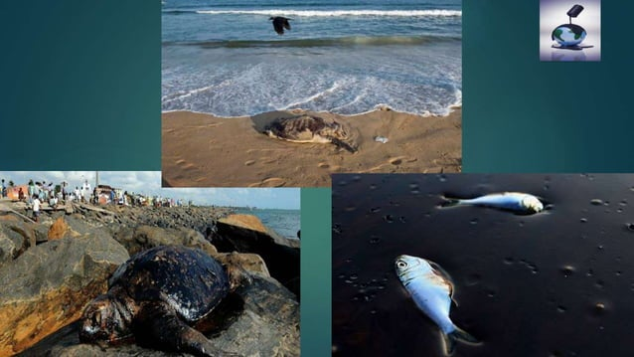
Impacts on Marine Environment
Marine mammals
  Furry animals can suffer from hypothermia if the fur is oiled.
  Generally, impacts are mild with skin irritations and disruption the most reported.
  Mortality is usually rare following an oil spill.
CGPRT(W) : Ensuring Clean Seas and Coasts in Western Region ……

Slide 21
Impacts on Marine Environment
Sea turtles
  All species are endangered.
  They are vulnerable to oil particularly during nesting season and in shallow waters.
  They use sand beaches for nesting and to lay eggs so clean-up of these areas during nesting season will be high priority.
  Adults can suffer irritation and inflammation of membranes.
  It is possible to clean sea turtles.
CGPRT(W) : Ensuring Clean Seas and Coasts in Western Region ……

Slide 22
Impacts on Marine Environment
Seabirds, wildfowl and waders
  Are vulnerable to floating oil.
  Large numbers can die from contact with floating oil at sea or on shorelines.
  Oil disrupts the feathers, affecting insulation properties which results in hypothermia.
  Birds will also ingest oil as they attempt to clean their feathers.
  Exhaustion resulting from smothering, particularly following exposure to viscous oils, is a commonly observed effect.
CGPRT(W) : Ensuring Clean Seas and Coasts in Western Region ……

Slide 23
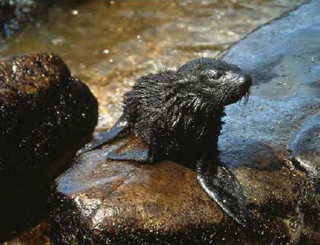
Impacts on Marine Environment
Seabirds, wildfowl and waders
  Contamination of habitat especially during nesting season can cause significant impacts.
  Oiled birds can be cleaned and rehabilitated but depending on species it may be that only a small fraction will survive.
  Short and long term damage is possible for
  individuals and population.
CGPRT(W) : Ensuring Clean Seas and Coasts in Western Region ……

Slide 24
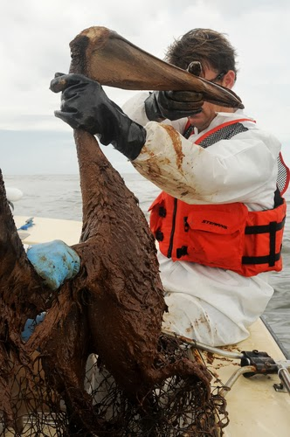
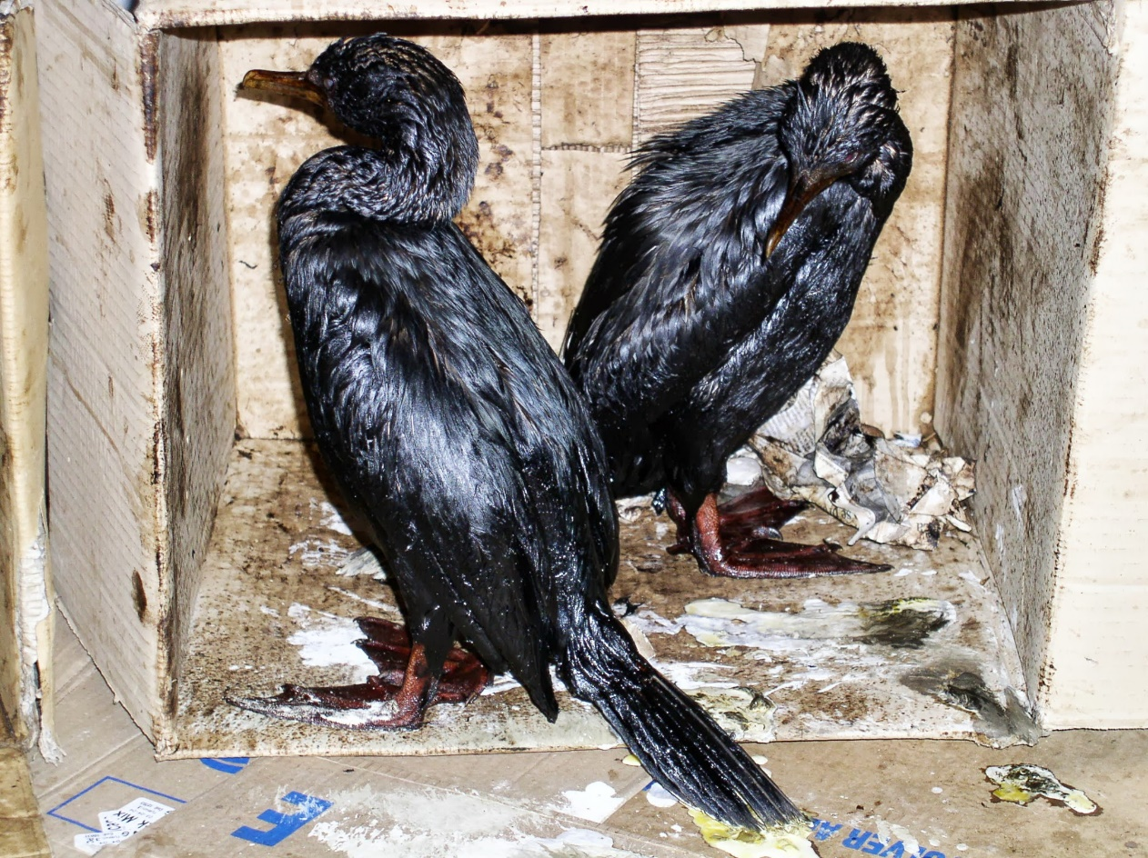
Impacts on Marine Environment
Seabirds, wildfowl and waders
CGPRT(W) : Ensuring Clean Seas and Coasts in Western Region ……

Slide 25
Impacts on Marine Environment
Corals
  Highly sensitive organisms
  Long recovery time if exposed to oil
  Can be exposed to dispersed oil especially near shore with high energy breaking waves
  Exposed coral reef can be affected by floating oil
  High priority areas for protection
CGPRT(W) : Ensuring Clean Seas and Coasts in Western Region ……

Slide 26
Impacts on Coastal Environment
CGPRT(W) : Ensuring Clean Seas and Coasts in Western Region ……

Slide 27
Impacts on Coastal Environment
Shorelines
  Shorelines are almost always impacted during an oil spill.
  Degree of sensitivity to oil is very variable between shoreline types.
  Impact is related to oil persistence and biological activity.
CGPRT(W) : Ensuring Clean Seas and Coasts in Western Region ……

Slide 28
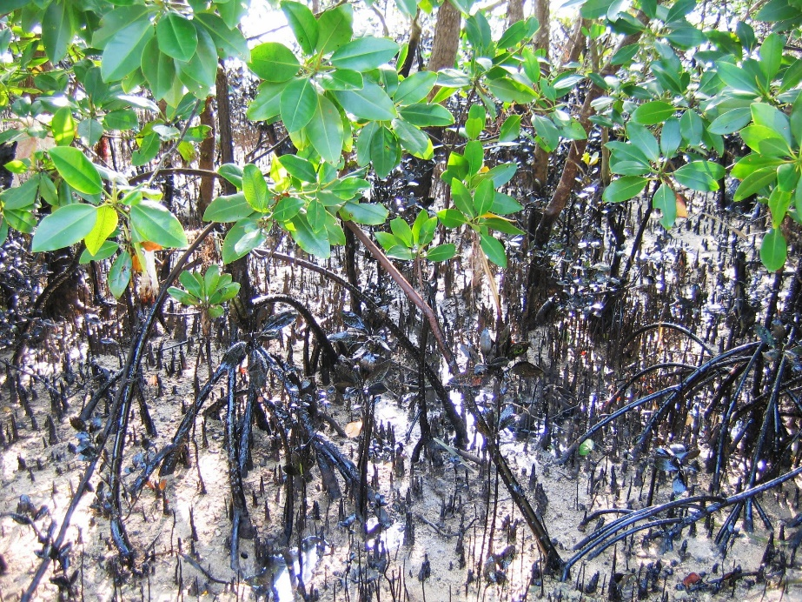
Impacts on Coastal Environment
Mangroves
  Highly sensitive to oil.
  Trees suffer from asphyxia from oil coating of roots and pores.
  Clean-up is extremely difficult and recovery can take decades.
Source: ITOPF
CGPRT(W) : Ensuring Clean Seas and Coasts in Western Region ……

Slide 29
Impacts on Coastal Environment
Marshes
  High biological importance.
  Plants are relatively resistant to oiling
    Will depend on growth cycle.
  Long-term impacts due to oil penetration in the substrate affecting the root system.
  Penetration is generally caused by trampling or use of mechanical equipment.
  Needs to be considered on a case by case basis.
CGPRT(W) : Ensuring Clean Seas and Coasts in Western Region ……

Slide 30
Impacts on Coastal Environment
Mud flats
  Used by many vertebrate and invertebrate species.
  Low energy shoreline.
  Long term impacts are generally caused by oil penetration in sediments caused by trampling or by oil penetration through worm burrows.
CGPRT(W) : Ensuring Clean Seas and Coasts in Western Region ……

Slide 31
Impacts on Coastal Environment
Rocky shorelines
  Less biologically active.
  Usually, they are colonized by algae or small invertebrates.
  Recolonization can be rapid following an oil spill.
  Short term impacts are typical for these shorelines.
CGPRT(W) : Ensuring Clean Seas and Coasts in Western Region ……

Slide 32
Impacts on Coastal Environment
Sandy shorelines
  Less biologically active.
  Short term impacts are typical for these shorelines.
  Potential for oil burial due to sand movement.
  Potential for oil and sand interaction in the intertidal zone leading to sunken oil.
CGPRT(W) : Ensuring Clean Seas and Coasts in Western Region ……

Slide 33
Impacts on Marine/Coastal Environment
Post spill studies
  Various studies can be undertaken to evaluate environmental damages
    Chemical analysis, population inventories, etc.
  Should have clear objectives, achievable goals and focus on likely impacts from the spill.
  Importance of pre spill background data.
Restoration measures can be identified and implemented in some cases.
CGPRT(W) : Ensuring Clean Seas and Coasts in Western Region ……

Slide 34
Impacts Affecting Operational Response
The impacts of oil spills on the various activities and environments can affect the operational response.
  Public/media attention to operational activities especially in areas of high population density.
  Access restrictions due to the impacts proximity to sensitivities such as cultural sites, private property, etc.
  Seasonal restrictions due wildlife nesting, etc.
  Prioritization of operational activities.
CGPRT(W) : Ensuring Clean Seas and Coasts in Western Region ……

Slide 35
Conclusion
Oil spills interfere with coastal activities.
Effects on marine life are caused by:
  physical contamination and smothering;
  tainting as a result of the smothering and toxic effects.
Health of biological populations is more important than individuals.
CGPRT(W) : Ensuring Clean Seas and Coasts in Western Region ……

Slide 36
Any questions?
CGPRT(W) : Ensuring Clean Seas and Coasts in Western Region ……

